Slide 1
CS258: Information Theory
Fan Cheng Shanghai Jiao Tong University
http://www.cs.sjtu.edu.cn/~chengfan/
chengfan@sjtu.edu.cn
Spring, 2023

Slide 2
Outline
Differential Entropy
AEP for Continuous Random Variable
Relative Entropy and Mutual Information
Property of Differential Information Measures
Information inequalities and applications

Slide 3
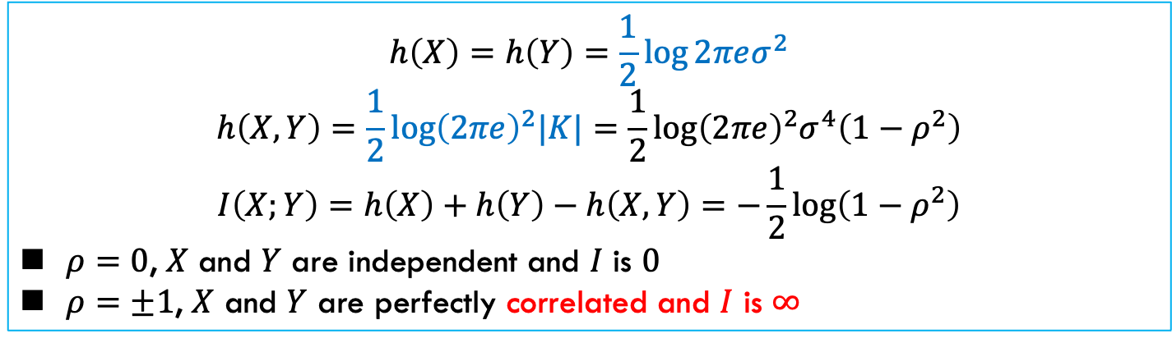
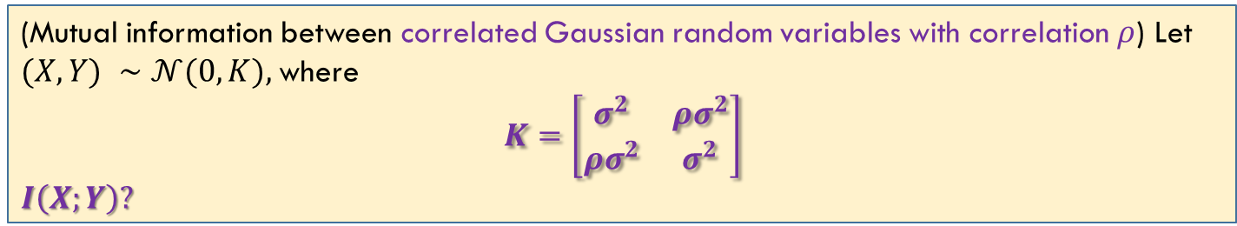
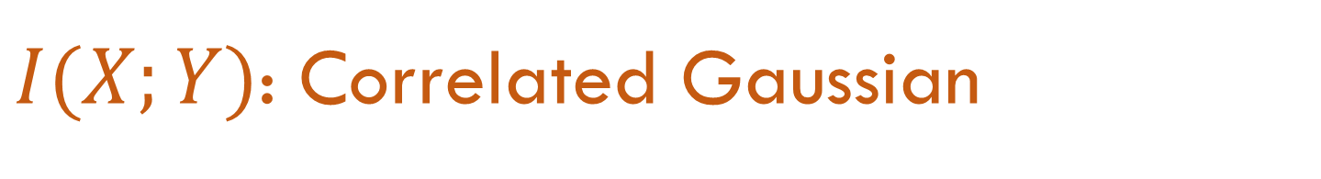
$I(X;Y)$: Correlated Gaussian
(Mutual information between correlated Gaussian random variables with correlation $ρ$) Let $(X, Y) ∼𝒩(0,K),$where
$$K=\left[\begin{matrix}σ^{2} & ρσ^{2} \\ ρσ^{2} & σ^{2}\end{matrix}\right]$$
$$I\left(X;Y\right)?$$
$$h\left(X\right)=h\left(Y\right)=\frac{1}{2}\log{2πeσ^{2}}$$
$$h\left(X,Y\right)=\frac{1}{2}\log{{\left(2πe\right)}^{2}|K|}=\frac{1}{2}\log{{\left(2πe\right)}^{2}σ^{4}\left(1−ρ^{2}\right)}$$
$$I\left(X;Y\right)=h\left(X\right)+h\left(Y\right)−h\left(X,Y\right)=−\frac{1}{2}\log\left(1−ρ^{2}\right)$$
$ρ=0$, $X$ and $Y$ are independent and $I$ is $0$
$ρ=±1$, $X$ and $Y$ are perfectly correlated and $I$ is $∞$

Slide 4
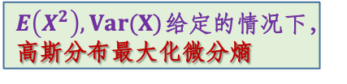
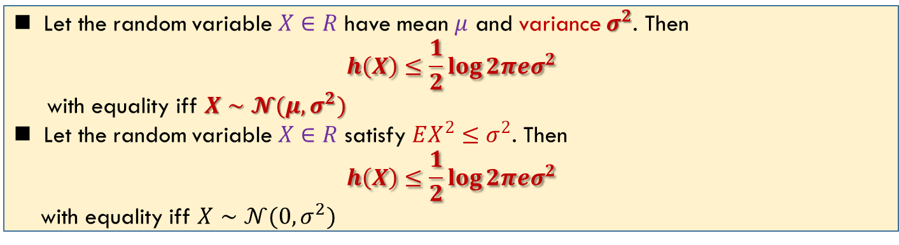
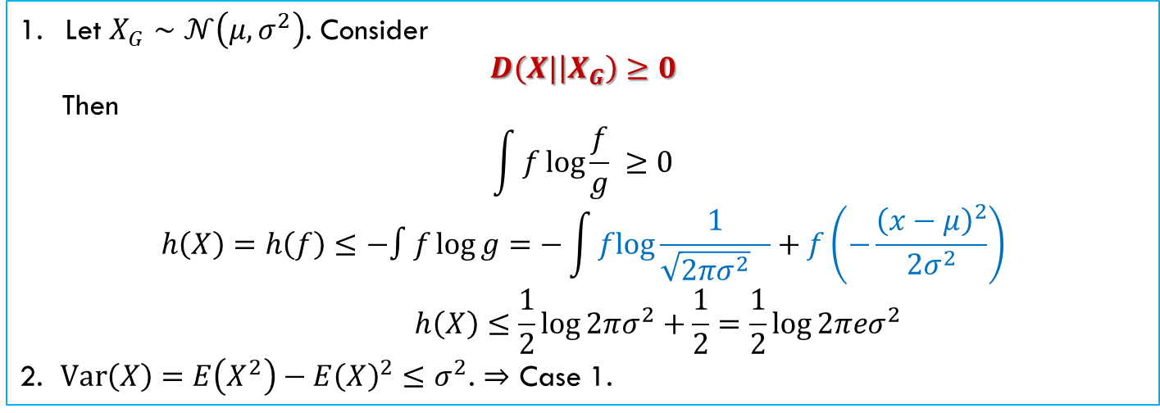
Maximum Entropy with Constraints
掌握
Let the random variable $X∈R$ have mean $μ$ and variance $σ^{2}$. Then
$$h\left(X\right)≤\frac{1}{2}\log{2πeσ^{2}}$$
with equality iff $X∼𝓝(μ,σ^{2})$
Let the random variable $X∈R$ satisfy $EX^{2}≤σ^{2}$. Then
$$h\left(X\right)≤\frac{1}{2}\log{2πeσ^{2}}$$
with equality iff $X∼𝒩(0, σ^{2})$
Let $X_{G}∼𝒩\left(μ,σ^{2}\right)$. Consider
$$D(X|\left|X_{G}\right)≥0$$
Then
$$\int{f\log{\frac{f}{g}} }≥0$$
$$h\left(X\right)=h\left(f\right)≤−∫f\log{g}=−\int{flog\frac{1}{\sqrt{2πσ^{2}} }+f\left(−\frac{{\left(x−μ\right)}^{2}}{2σ^{2}}\right)}$$
$$h\left(X\right)≤\frac{1}{2}log{2πσ^{2}}+\frac{1}{2}=\frac{1}{2}\log{2πeσ^{2}}$$
2. $Var\left(X\right)=E\left(X^{2}\right)−E{\left(X\right)}^{2}≤σ^{2}$. $⇒$ Case 1.
相对熵大于等于0
$E\left(X^{2}\right),Var(X)$给定的情况下，高斯分布最大化微分熵

Slide 5
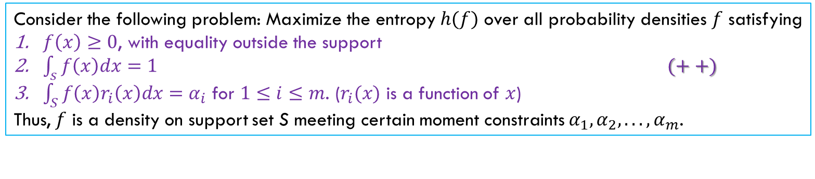
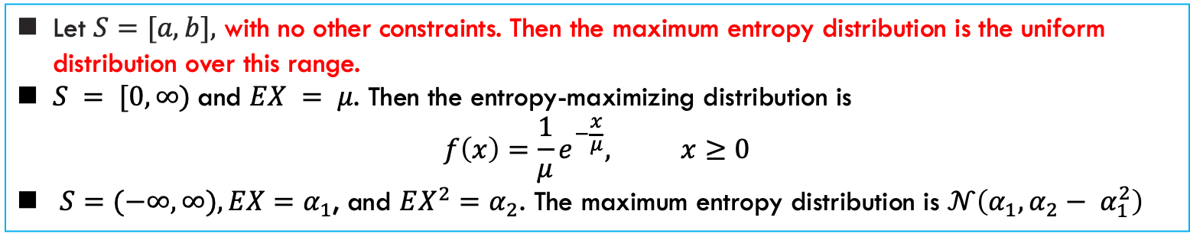
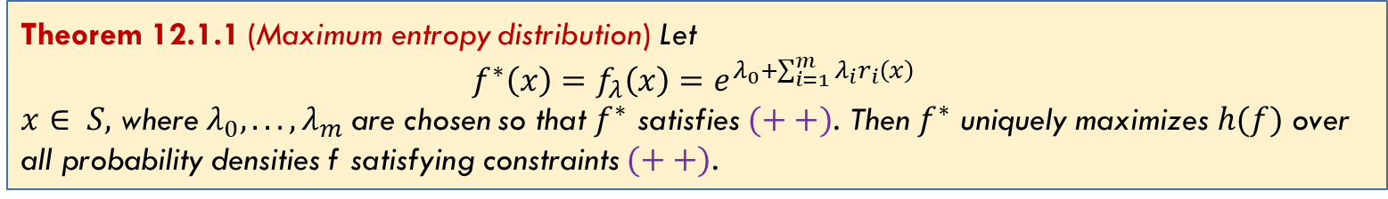
不做要求，记住结论
Maximum Entropy
Consider the following problem: Maximize the entropy $h(f)$ over all probability densities $f$ satisfying
$f\left(x\right)≥0$, with equality outside the support
$\int_{s}{f\left(x\right)dx}=1$ $(++)$
$\int_{S}{f\left(x\right)r_{i}\left(x\right)dx}=α_{i}$ for $1≤i≤m$. ($r_{i}(x)$ is a function of $x$)
Thus, $f$ is a density on support set S meeting certain moment constraints $α_{1}, α_{2}, . . . , α_{m}$.
Theorem 12.1.1 (Maximum entropy distribution) Let
$$f^{∗}\left(x\right)=f_{λ}\left(x\right)=e^{λ_{0}+\sum_{i=1}^{m}{λ_{i}r_{i}\left(x\right)}}$$
$x∈ S,$ where $λ_{0}, . . . , λ_{m}$are chosen so that $f^{∗}$ satisfies $(++)$. Then $f^{∗}$ uniquely maximizes $h(f)$ over all probability densities f satisfying constraints $(++)$.
Let $S=[a, b],$ with no other constraints. Then the maximum entropy distribution is the uniform distribution over this range.
$S = [0,∞)$and $EX = μ$. Then the entropy-maximizing distribution is
$$f\left(x\right)=\frac{1}{μ}e^{−\frac{x}{μ}}, x≥0$$
$S=(−∞,∞), EX=α_{1}$, and $EX^{2}=α_{2}$. The maximum entropy distribution is $𝒩\left(α_{1}, α_{2}− α_{1}^{2}\right)$
Ref: Cover Ch. 12

Slide 6
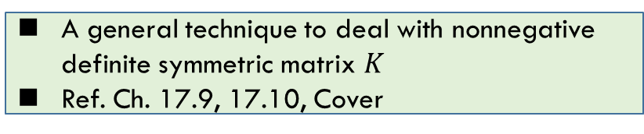
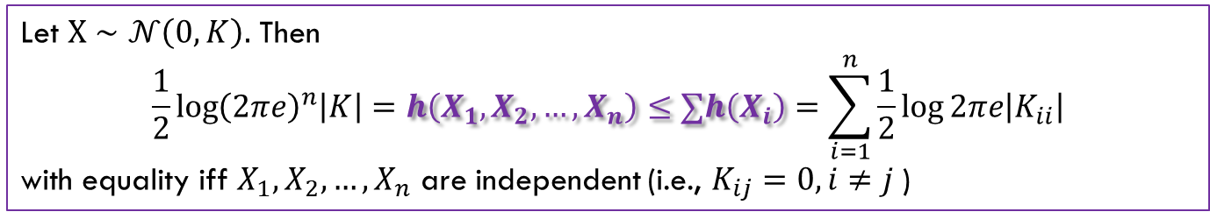
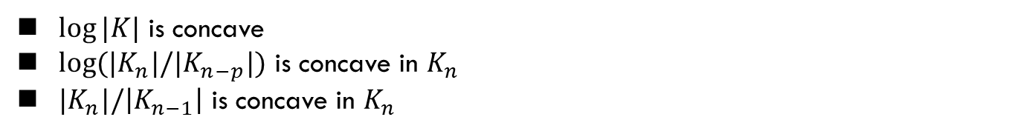
Hadamard’s Inequality
只要知道是用高斯分布处理就行
$K$ is a nonnegative definite symmetric $n×n$ matrix. Let $|K|$ denote the determinant of $K$.
Theorem (Hadamard) $\left|K\right|≤∏K_{ii}$, with equality iff $K_{ij}=0, i≠j$
Let $X∼𝒩\left(0,K\right).$ Then
$$\frac{1}{2}\log{{\left(2πe\right)}^{n}\left|K\right|}=h\left(X_{1},X_{2},…,X_{n}\right)≤∑h\left(X_{i}\right)=\sum_{i=1}^{n}{\frac{1}{2}\log{2πe\left|K_{ii}\right|}}$$
with equality iff $X_{1}, X_{2},…,X_{n}$ are independent (i.e., $K_{ij}=0, i≠j$)
$\log{|K|}$ is concave
$log⁡(|K_{n}|/|K_{n−p}|)$ is concave in $K_{n}$
$|K_{n}|/\left|K_{n−1}\right|$ is concave in $K_{n}$
A general technique to deal with nonnegative definite symmetric matrix $K$
Ref. Ch. 17.9, 17.10, Cover

Slide 7
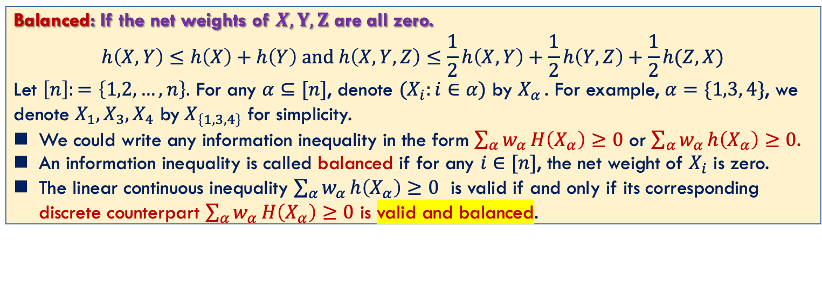
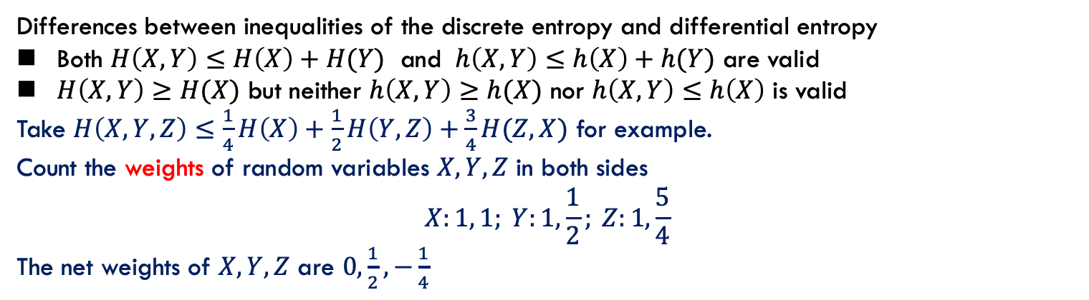
结论可以直接用，
不会直接考这样的不等式
Balanced Information Inequality
Differences between inequalities of the discrete entropy and differential entropy
Both $H\left(X,Y\right)≤H\left(X\right)+H(Y)$ and $h\left(X,Y\right)≤h\left(X\right)+h(Y)$ are valid
$H\left(X,Y\right)≥H(X)$ but neither $h\left(X,Y\right)≥h(X)$ nor $h\left(X,Y\right)≤h\left(X\right)$ is valid
Take $H\left(X,Y,Z\right)≤\frac{1}{4}H\left(X\right)+\frac{1}{2}H\left(Y,Z\right)+\frac{3}{4}H(Z,X)$ for example.
Count the weights of random variables $X,Y,Z$ in both sides
$$X:1, 1; Y:1,\frac{1}{2}; Z:1,\frac{5}{4}$$
The net weights of $X, Y, Z$ are $0,\frac{1}{2}, −\frac{1}{4}$
Balanced: If the net weights of $X, Y, Z$ are all zero.
$$h\left(X,Y\right)≤h\left(X\right)+h\left(Y\right) and h\left(X,Y,Z\right)≤\frac{1}{2}h\left(X,Y\right)+\frac{1}{2}h\left(Y,Z\right)+\frac{1}{2}h(Z,X)$$
Let $\left[n\right]:=\left\{1,2,…,n\right\}.$ For any $α⊆[n]$, denote $(X_{i}:i∈α)$ by $X_{α }$. For example, $α=\{1,3, 4\}$, we denote $X_{1},X_{3},X_{4}$ by$X_{\left\{1,3,4\right\}}$ for simplicity.
We could write any information inequality in the form $\sum_{α}{w_{α}}H\left(X_{α}\right)≥0$ or $\sum_{α}{w_{α}}h\left(X_{α}\right)≥0$.
An information inequality is called balanced if for any $i∈[n]$, the net weight of $X_{i}$ is zero.
The linear continuous inequality $\sum_{α}{w_{α}}h\left(X_{α}\right)≥0$ is valid if and only if its corresponding discrete counterpart $\sum_{α}{w_{α}}H\left(X_{α}\right)≥0$ is valid and balanced.
H(X) + H(Y) >= H(X,Y)
Ref: Balanced Information Inequalities, T. H. Chan, IEEE Transactions on Information Theory, Vol. 49, No. 12, December 2003

Slide 8
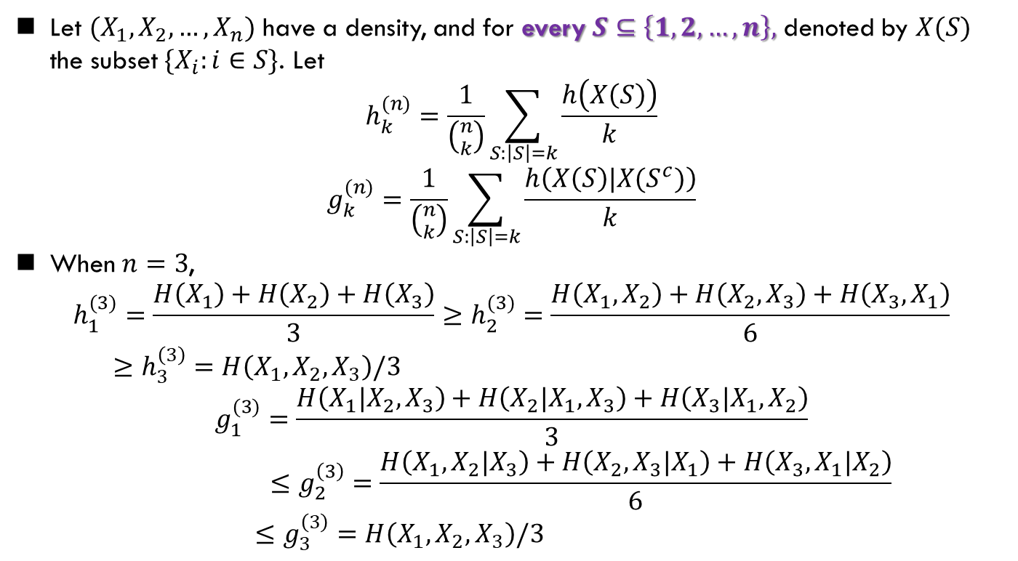
Han’s Inequality
知道有这个不等式，低维证明掌握，高维归纳
Let $(X_{1},X_{2},…,X_{n})$ have a density, and for every $S⊆\left\{1,2,…,n\right\},$ denoted by $X(S)$ the subset $\{X_{i}:i∈S\}$. Let
$$h_{k}^{(n)}=\frac{1}{\left({n \atop k}\right)}\sum_{S:\left|S\right|=k}{\frac{h\left(X\left(S\right)\right)}{k}}$$
$$g_{k}^{(n)}=\frac{1}{\left({n \atop k}\right)}\sum_{S:\left|S\right|=k}{\frac{h\left(X\left(S\right)|X(S^{c})\right)}{k}}$$
When $n=3$,
$$h_{1}^{(3)}=\frac{H\left(X_{1}\right)+H\left(X_{2}\right)+H\left(X_{3}\right)}{3}≥h_{2}^{(3)}=\frac{H\left(X_{1},X_{2}\right)+H\left(X_{2},X_{3}\right)+H\left(X_{3},X_{1}\right)}{6}$$
$$≥h_{3}^{\left(3\right)}=H\left(X_{1},X_{2},X_{3}\right)/3$$
$$g_{1}^{(3)}=\frac{H\left(X_{1}|X_{2},X_{3}\right)+H\left(X_{2}|X_{1},X_{3}\right)+H\left(X_{3}|X_{1},X_{2}\right)}{3}$$
$$≤g_{2}^{\left(3\right)}=\frac{H\left(X_{1},X_{2}|X_{3}\right)+H\left(X_{2},X_{3}|X_{1}\right)+H\left(X_{3},X_{1}|X_{2}\right)}{6}$$
$$≤g_{3}^{\left(3\right)}=H\left(X_{1},X_{2},X_{3}\right)/3$$
Han’s inequality:
$$h_{1}^{(n)}≥h_{2}^{\left(n\right)}…≥h_{n}^{\left(n\right)}=H\left(X_{1},X_{2},…,X_{n}\right)/n=g_{n}^{\left(n\right)}≥…≥g_{2}^{\left(n\right)}≥g_{1}^{\left(n\right)}$$

Slide 9
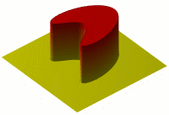
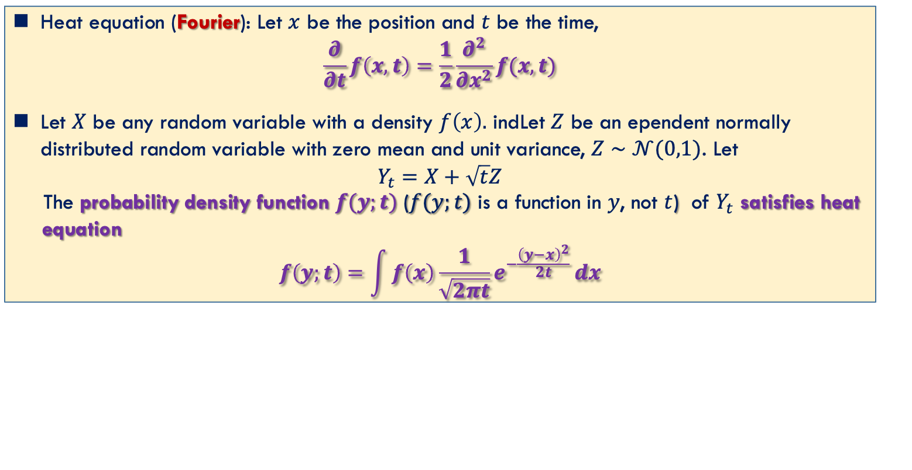
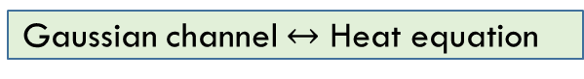
Information of Heat
不要求
Heat equation (Fourier): Let $x$ be the position and $t$ be the time,
$$\frac{∂}{∂t}f\left(x,t\right)=\frac{1}{2}\frac{∂^{2}}{∂x^{2}}f(x, t)$$
Let $X$ be any random variable with a density $f\left(x\right).$ indLet $Z$ be an ependent normally distributed random variable with zero mean and unit variance, $Z∼𝒩(0,1)$. Let
$$Y_{t}=X+\sqrt{t}Z$$
The probability density function $f(y;t)$ ($f(y;t)$ is a function in $y$, not $t$) of $Y_{t}$ satisfies heat
equation
$$f\left(y;t\right)=\int{f\left(x\right)\frac{1}{\sqrt{2πt}}e^{−\frac{{\left(y−x\right)}^{2}}{2t} }dx}$$
Gaussian channel $↔$ Heat equation

Slide 10
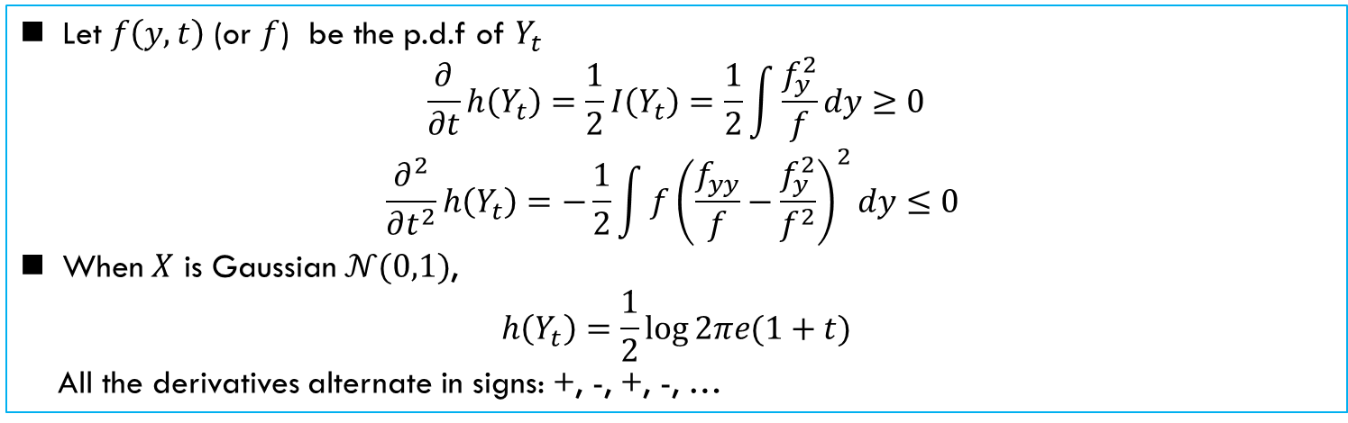
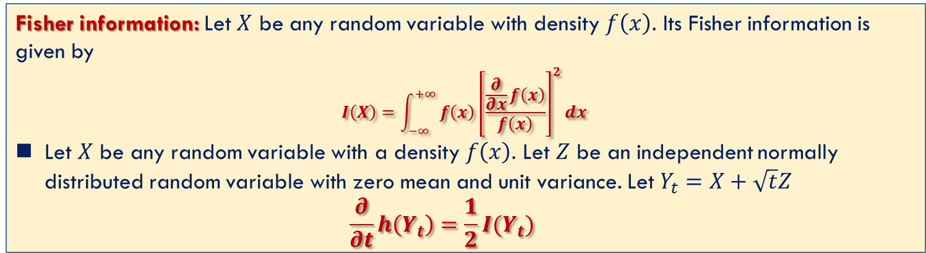
Entropy and Fisher Information
不要求
Fisher information: Let $X$ be any random variable with density $f\left(x\right).$ Its Fisher information is given by
$$I\left(X\right)=\int_{−∞}^{+∞}{f\left(x\right){\left[\frac{\frac{∂}{∂x}f\left(x\right)}{f\left(x\right)}\right]}^{2}dx }$$
Let $X$ be any random variable with a density $f\left(x\right).$ Let $Z$ be an independent normally distributed random variable with zero mean and unit variance. Let $Y_{t}=X+\sqrt{t}Z$
$$\frac{∂}{∂t}h\left(Y_{t}\right)=\frac{1}{2}I(Y_{t})$$
Let $f\left(y,t\right)$ (or $f$) be the p.d.f of $Y_{t}$
$$\frac{∂}{∂t}h\left(Y_{t}\right)=\frac{1}{2}I\left(Y_{t}\right)=\frac{1}{2}\int{\frac{f_{y}^{2}}{f}dy}≥0$$
$$\frac{∂^{2}}{∂t^{2}}h\left(Y_{t}\right)=−\frac{1}{2}\int{{f\left(\frac{f_{yy}}{f}−\frac{f_{y}^{2}}{f^{2}}\right)}^{2}dy}≤0$$
When $X$ is Gaussian $𝒩(0,1)$,
$$h\left(Y_{t}\right)=\frac{1}{2}\log{2πe(1+t)}$$
All the derivatives alternate in signs: +, -, +, -, …

Slide 11
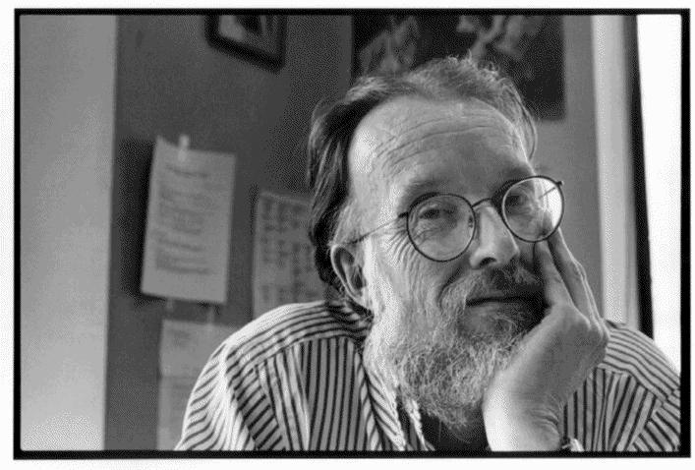
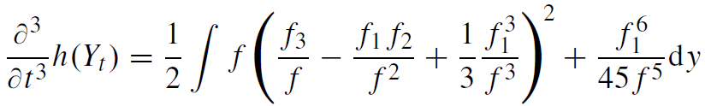
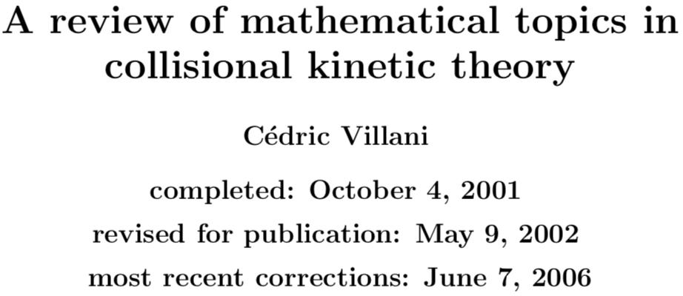
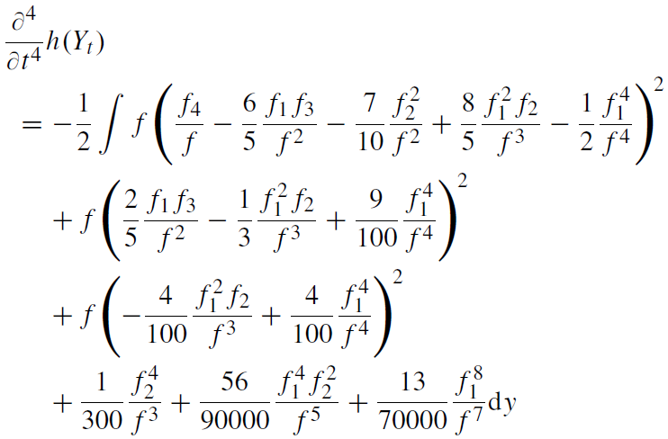

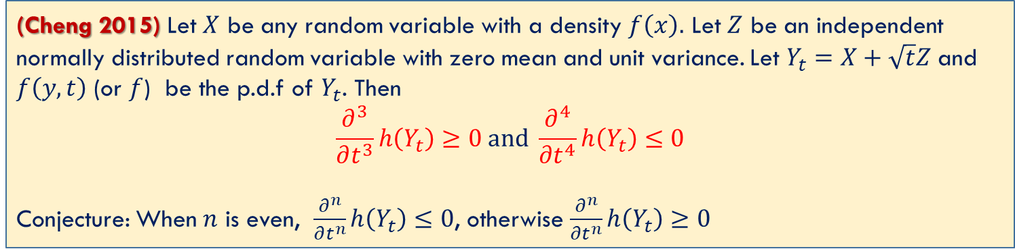
Higher Order Derivatives of $h(Y_{t})$
不要求
(Cheng 2015) Let $X$ be any random variable with a density $f\left(x\right).$ Let $Z$ be an independent normally distributed random variable with zero mean and unit variance. Let $Y_{t}=X+\sqrt{t}Z$ and $f\left(y,t\right)$ (or $f$) be the p.d.f of $Y_{t}$. Then
$$\frac{∂^{3}}{∂t^{3}}h\left(Y_{t}\right)≥0 and \frac{∂^{4}}{∂t^{4}}h\left(Y_{t}\right)≤0$$
Conjecture: When $n$ is even, $\frac{∂^{n}}{∂t^{n}}h\left(Y_{t}\right)≤0$, otherwise $\frac{∂^{n}}{∂t^{n}}h\left(Y_{t}\right)≥0$
“This suggests that……, etc., but I could not prove it” (1966)
H. P. McKean
C. Villani
2010 Fields medalist
Gaussian completely monotone conjecture (简称GCMC, 完全单调猜想)
[1]. F. Cheng and Y. Geng, ‘‘Higher Order Derivatives in Costa's Entropy Power Inequality’’

Slide 12
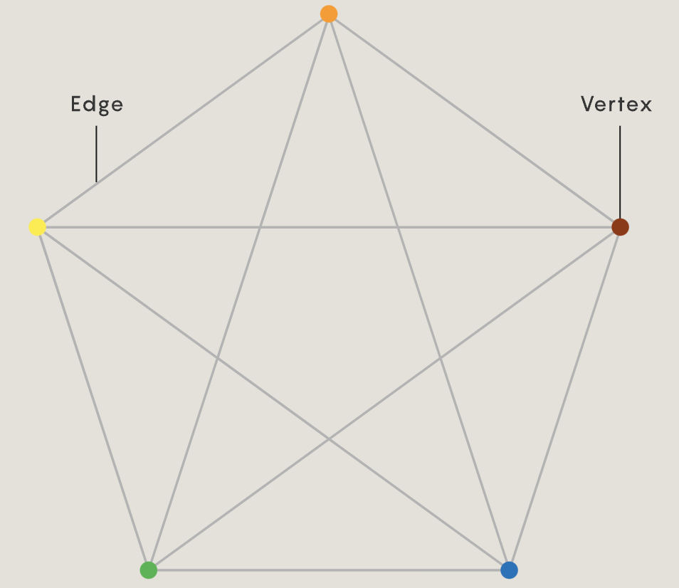
GCMC and Hodge theory
June Huh（许埈珥）
2022 Fields Medal
Chromatic polynomial（染色多项式）的系数构成一个log-concave序列 (开放了50多年)
J. Huh使用代数几何的Hodge理论研究组合学，通过构造性地证明解决了
问题1：chromatic polynomial
问题2：matroid
问题3：geometry lattice
GCMC中也有log-concave结构
"We believe that behind any log-concave sequence that appears in nature there is such a Hodge structure responsible for the log-concavity”
June Huh
[1]. https://www.quantamagazine.org/june-huh-high-school-dropout-wins-the-fields-medal-20220705/

Slide 13
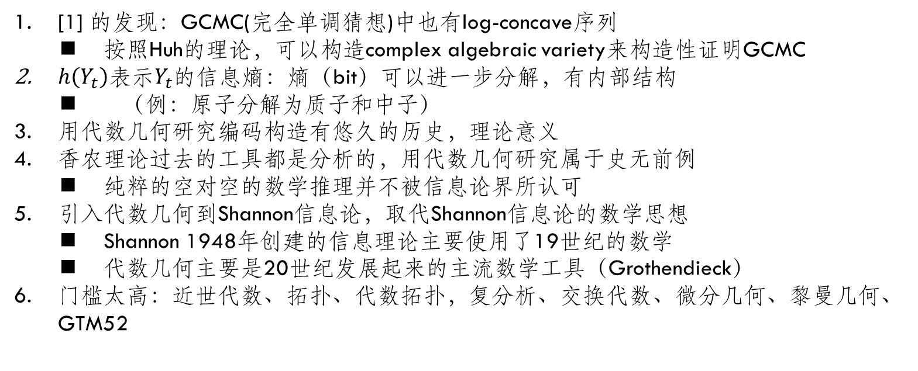
Information theory 2.0
[1] 的发现：GCMC(完全单调猜想)中也有log-concave序列
按照Huh的理论，可以构造complex algebraic variety来构造性证明GCMC
$h\left(Y_{t}\right)$表示$Y_{t}$的信息熵：熵（bit）可以进一步分解，有内部结构
（例：原子分解为质子和中子）
用代数几何研究编码构造有悠久的历史，理论意义
香农理论过去的工具都是分析的，用代数几何研究属于史无前例
纯粹的空对空的数学推理并不被信息论界所认可
引入代数几何到Shannon信息论，取代Shannon信息论的数学思想
Shannon 1948年创建的信息理论主要使用了19世纪的数学
代数几何主要是20世纪发展起来的主流数学工具（Grothendieck）
门槛太高：近世代数、拓扑、代数拓扑，复分析、交换代数、微分几何、黎曼几何、GTM52
[1]. A Reformulation of Gaussian Completely Monotone Conjecture: A Hodge Structure on the Fisher Information along Heat Flow
[2]. 信息论2.0 https://www.bilibili.com/video/BV1Fg411v7bG/

Slide 14
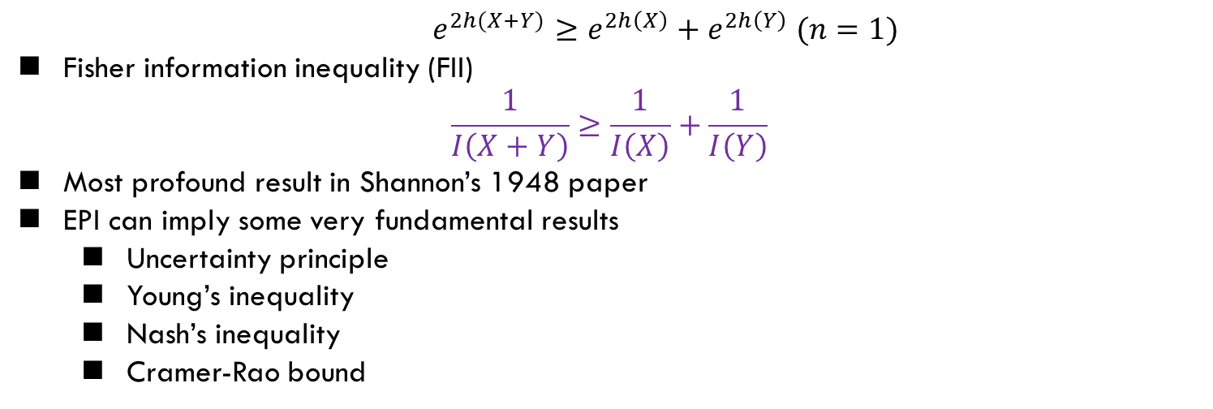
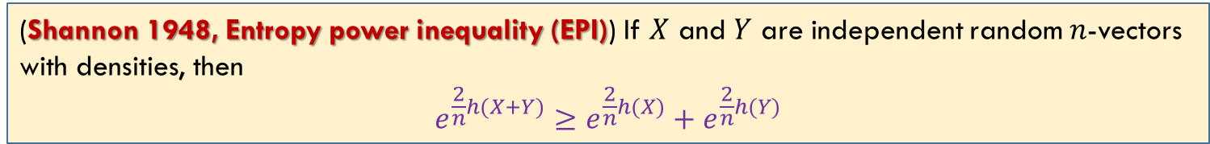
会用
EPI and FII
熵幂不等式
(Shannon 1948, Entropy power inequality (EPI)) If $X$ and $Y$ are independent random $n$-vectors with densities, then
$$e^{\frac{2}{n}h(X+Y)}≥e^{\frac{2}{n}h(X)}+e^{\frac{2}{n}h(Y)}$$
$$e^{2h(X+Y)}≥e^{2h\left(X\right)}+e^{2h\left(Y\right)} (n=1)$$
Fisher information inequality (FII)
$$\frac{1}{I\left(X+Y\right)}≥\frac{1}{I\left(X\right)}+\frac{1}{I\left(Y\right)}$$
Most profound result in Shannon’s 1948 paper
EPI can imply some very fundamental results
Uncertainty principle
Young’s inequality
Nash’s inequality
Cramer-Rao bound
Reference
T. Cover, ‘‘Information theoretic inequalities,’’ 1990
O. Rioul, “Information Theoretic Proofs of Entropy Power Inequalities,” 2011

Slide 15
Summary
Cover: 8.9, 12.1, 17.6, 17.7, 17.9, 17.10

